Slide 1
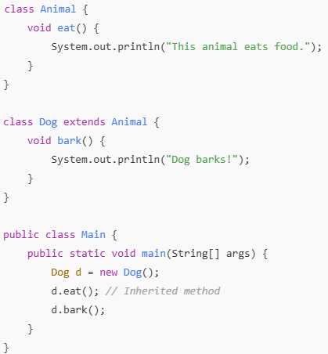
Inheritance in Java
Definition:
Inheritance is a mechanism in Java where one class acquires the properties and methods of another.
Key Points:
  Enables reusability of code.
  Superclass (parent) and Subclass (child).
  Keyword: extends.

Slide 2
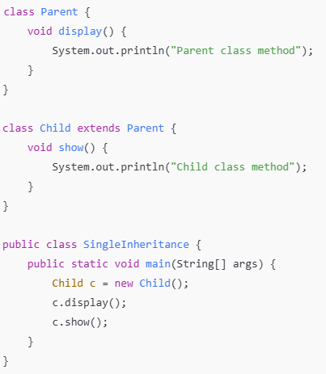
Types of Inheritance in Java
Single Inheritance
Definition: A single subclass inherits from one superclass.

Slide 3
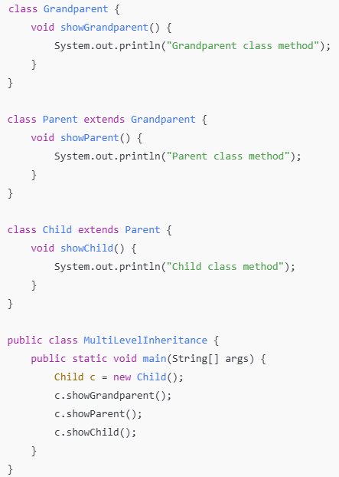
Multi-level Inheritance
Definition: A class inherits from a class, and another class inherits from it.

Slide 4
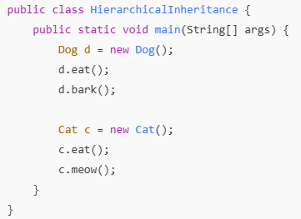
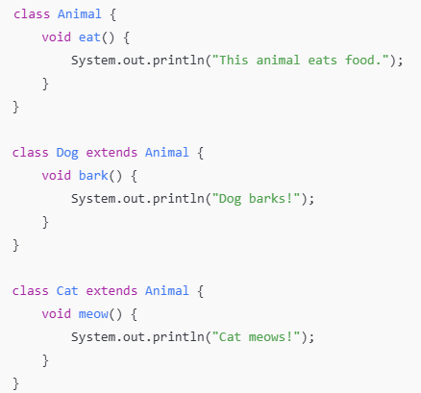
Hierarchical Inheritance
Definition: Multiple subclasses inherit from a single superclass.

Slide 5
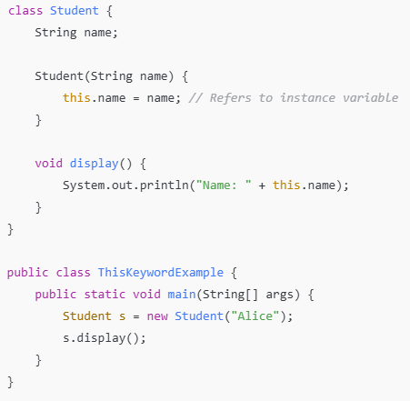
Resolving Variable Name Conflicts
Use of this Keyword
Definition:
The this keyword is used to refer to the current object of a class.
Key Points:
  Refers to the current object.
  Resolves variable name conflicts.
  Used to call current class methods or constructors.

Slide 6
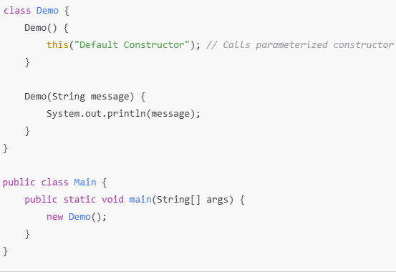
Calling Constructor

Slide 7
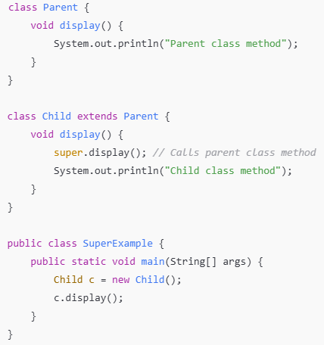
Accessing Parent Class Members
Use of super Keyword
Definition:
The super keyword is used to refer to the immediate parent class.
Key Points:
  Access parent class variables and methods.
  Invoke parent class constructors.

Slide 8
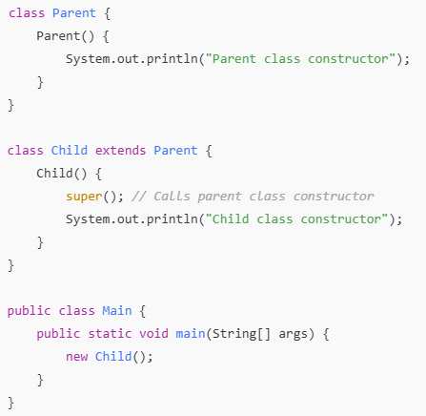
Calling Parent Class Constructor

Slide 9
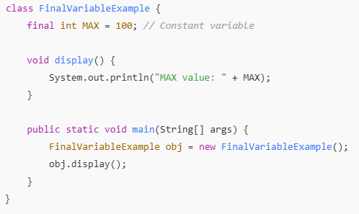
final Variables
Definition:
A final variable is a constant whose value cannot be changed after initialization.
Key Points:
  Must be initialized at the time of declaration or in a constructor.

Slide 10
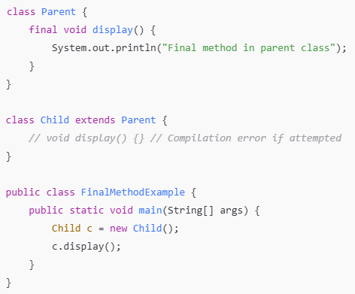
final Methods
Definition:
A final method cannot be overridden by a subclass.
Key Points:
  Ensures method behavior remains unchanged.

Slide 11
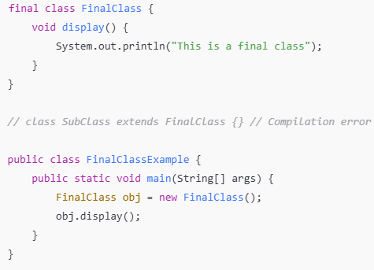
final Classes
Definition:
A final class cannot be extended by any subclass.
Key Points:
  Useful for creating immutable classes.

Slide 12
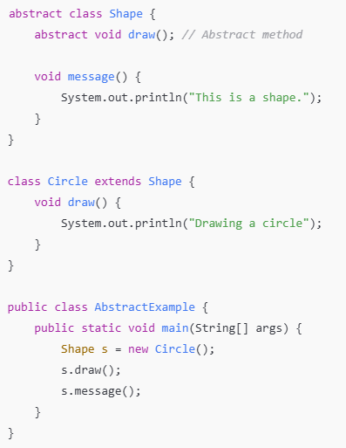
Abstract Keyword
Definition:
The abstract keyword is used to define classes or methods that are incomplete and must be implemented by a subclass.
Key Points:
  An abstract class cannot be instantiated.
  An abstract method has no body and must be implemented in a subclass.

Slide 13
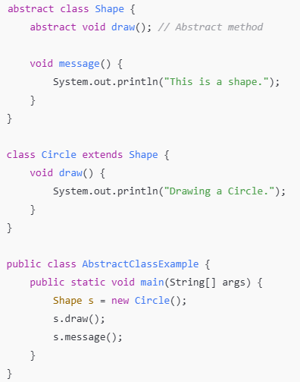
Abstract Classes in Java
Definition:
Abstract classes are classes that cannot be instantiated. They are declared using the abstract keyword.
Key Points:
  Can ementation) have abstract (no impland concrete methods.
  Must be extended by a subclass.

Slide 14
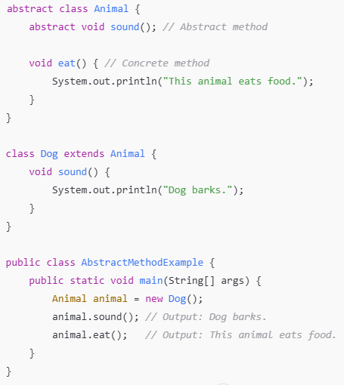
What Are Abstract Methods?
Definition:
Abstract methods are methods that are declared without an implementation (i.e., without a method body).
Key Points:
  Declared using the abstract keyword.
  Must be in an abstract class.
  Subclasses are required to provide implementations for all abstract methods.
  They are designed to define a blueprint for subclasses.

Slide 15
Key Characteristics of Abstract Methods
Points:
  Cannot be instantiated: Abstract methods exist only within abstract classes, which cannot be directly instantiated.
  Must be overridden: Subclasses must implement all abstract methods unless they are also abstract classes.
  Can coexist with concrete methods: Abstract classes can have both abstract and concrete methods.
  Used for polymorphism: Provides a way to achieve runtime polymorphism.

Slide 16
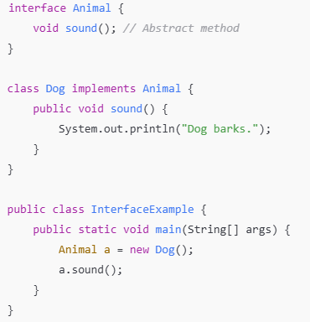
Interfaces in Java
Definition:
An interface is a blueprint of a class that contains abstract methods.
Key Points:
  Use the interface keyword.
  Supports multiple inheritance.
  Classes implement interfaces using the implements keyword.

Slide 17
Abstract class | Interface
1) Abstract class can have abstract and non-abstract methods. | Interface can have only abstract methods. Since Java 8, it can have default and static methods also.
2) Abstract class doesn't support multiple inheritance. | Interface supports multiple inheritance.
3) Abstract class can have final, non-final, static and non-static variables. | Interface has only static and final variables.
4) Abstract class can provide the implementation of interface. | Interface can't provide the implementation of abstract class.
5) The abstract keyword is used to declare abstract class. | The interface keyword is used to declare interface.
6) An abstract class can extend another Java class and implement multiple Java interfaces. | An interface can extend another Java interface only.
7) An abstract class can be extended using keyword "extends". | An interface can be implemented using keyword "implements".
8) A Java abstract class can have class members like private, protected, etc. | Members of a Java interface are public by default.

Slide 18
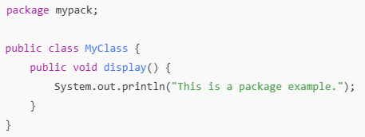
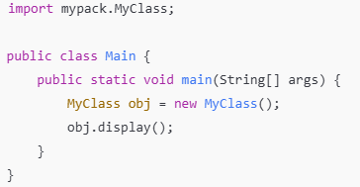
Packages in Java
Definition:
Packages are used to group related classes and interfaces together.
Key Points:
  Helps in organizing code.
  Avoids naming conflicts.
  Use package keyword.

